Slide 1
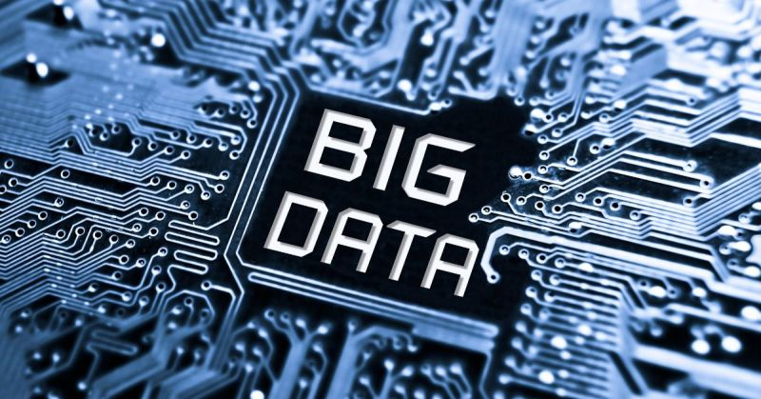
Introduction
Amount of data we generate?
402.74 quintillion bytes/day (Duarte, 2025) 【下一页】

Slide 2
Introduction
Humans cannot manually analyze terabytes
Unstructured/ Massive data (Ren, 2022).
Big data enable systematic strategies
e.g. Data Mining, Machine Learning

Slide 3
Introduction
Big data offers added benefits:
Uncover previously unnoticed patterns
Powers personalized recommendation systems

Slide 4
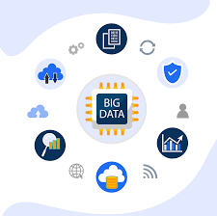
Conclusion
Uncovering hidden insights
Enabling intelligent personalization
Indispensable in modern society

Slide 5
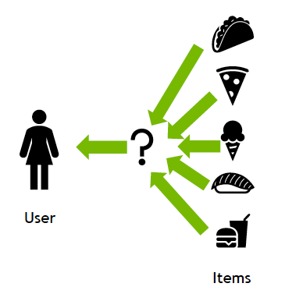
Conclusion
​​Data-driven personalized life enhancement​​
Big data analytics is everywhere
​​Big data's expanding societal role​​

